Slide 1
Dawa Bank Overview

Slide 2
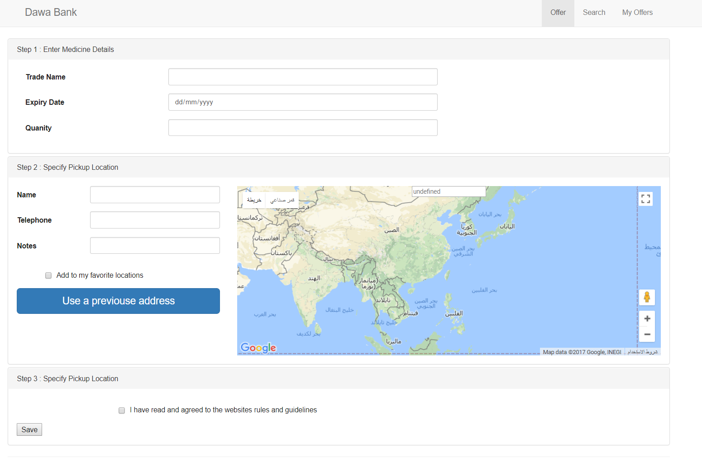
Donor page

Slide 3
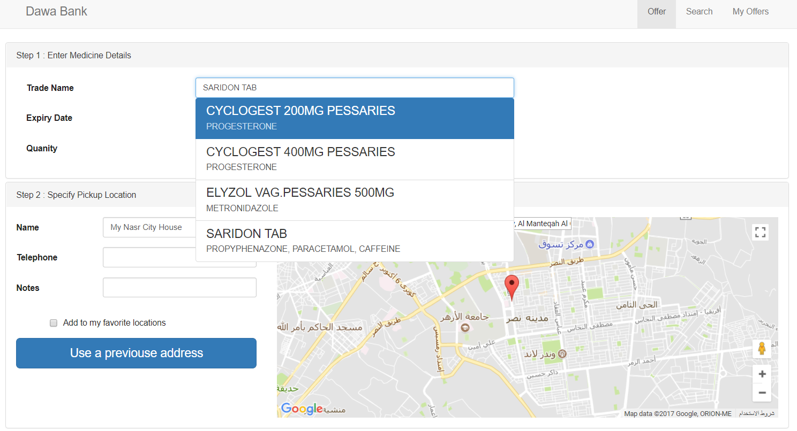
Donor Journey Donor selecting a medicine from list

Slide 4
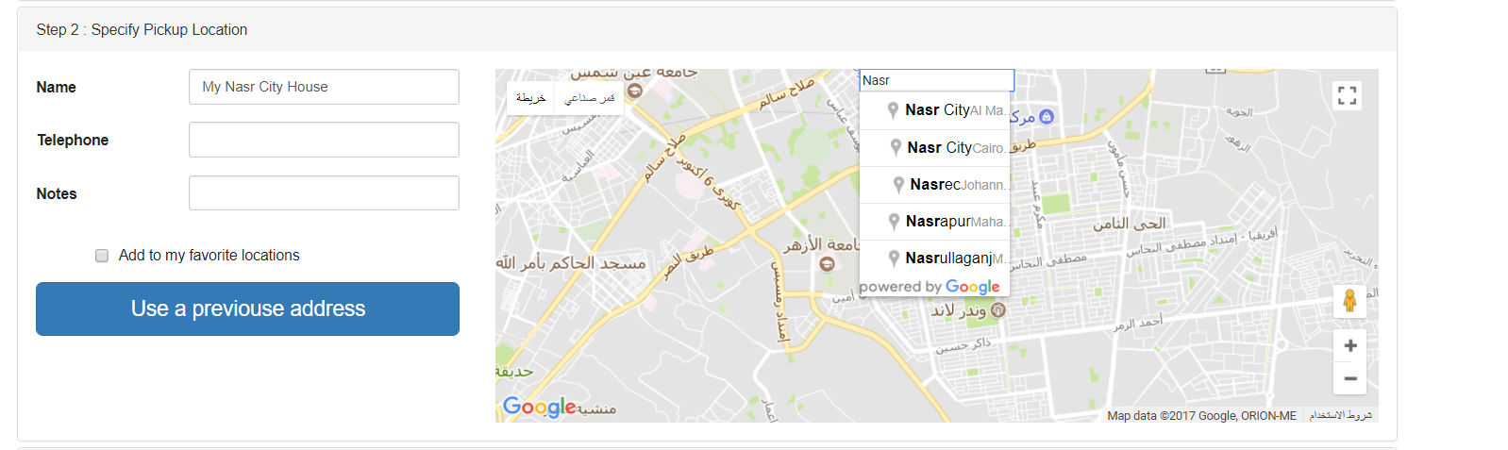
Donor entering a new location

Slide 5
Donor entering a new location

Slide 6
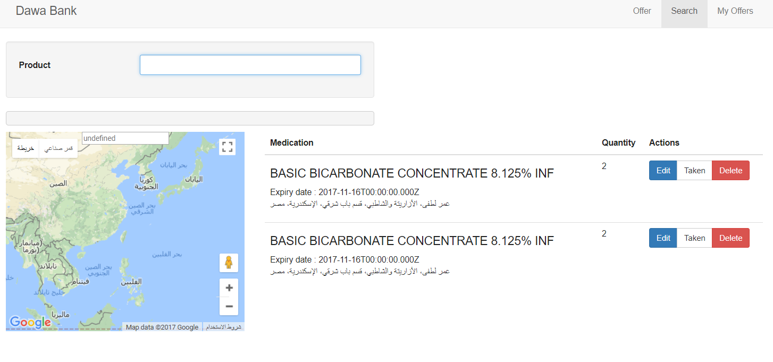
Search for medicine

Slide 7
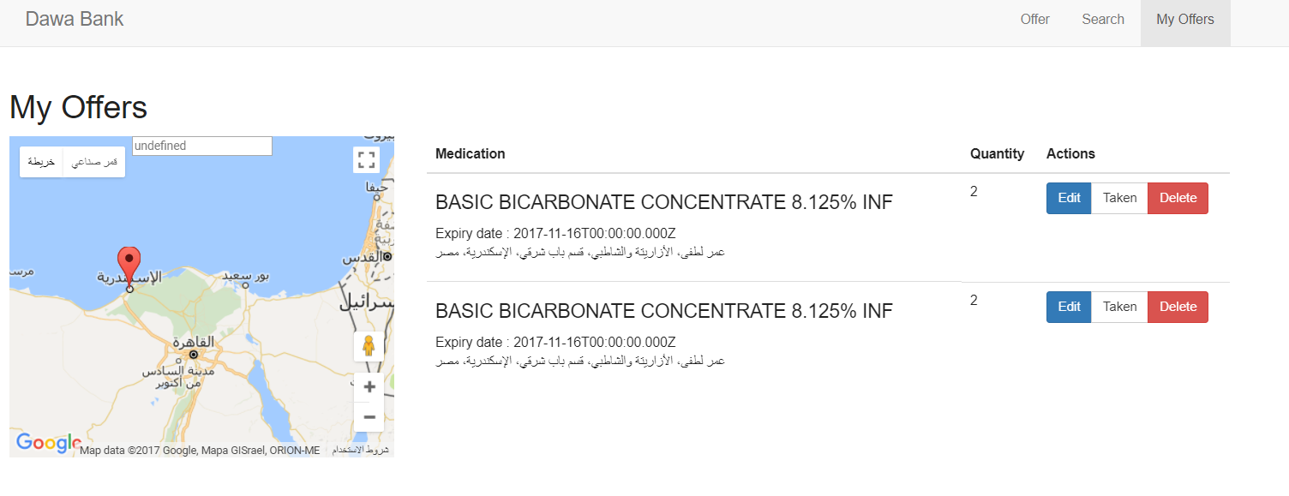
View my donations

